Slide 1

Telco Customer Churn Analysis & Retention
Identifying root causes of customer loss, key risk factors across contract types, and high-impact retention strategies to protect recurring revenue.

Slide 2


Business Problem & Objectives
The Core Problem
Analytical Objectives
The telecommunications company is experiencing ongoing customer churn, directly degrading recurring revenue streams and diminishing Customer Lifetime Value (CLV).
Question 1: Why are customers leaving the company during key lifecycle windows?
Question 2: Which specific characteristics (services, contract length, support, billing) contribute most heavily to customer churn?
Acquiring new subscribers requires significant capital expenditure; thus, preventing attrition among existing accounts is vital for sustainable growth.

Slide 3

Dataset Overview & Baseline
Dataset Scope & Baseline Metrics
The analysis evaluated the WA_Fn-UseC_-Telco-Customer-Churn dataset comprising 7,043 customer accounts and 21 detailed behavioral and billing features.
26.5%
•
Total Customers Evaluated: 7,043 accounts
•
Churned Customers: 1,869 accounts (26.54% churn rate)
Overall Churn Rate
•
Retained Customers: 5,174 accounts (73.46%)
•
Key Feature Domains: Customer tenure, internet services, contract types, add-on security/support, and billing/payment methods.

Slide 4
Tenure & Monthly Charges Analysis
Key Hypothesis 1 Findings
•
Shorter Customer Tenure: Churned customers leave primarily in the early stages of their relationship, demonstrating acute onboarding retention challenges.
•
Service Composition Paradox: Higher churn pricing is driven by service selection—69% of churners use Fiber Optic (vs 35% of retained users). Within the same service tier, retained users actually pay more!
•
Higher Monthly Bill Premium: Churned customers pay an average of $74.44/mo vs. $61.27/mo for retained accounts (+21.5% higher).

Slide 5
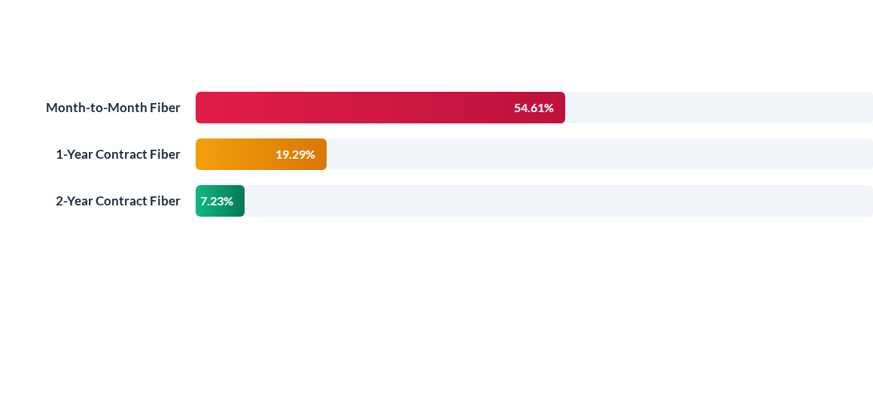
Contract Impact on Fiber Optic Churn
Hypothesis 3 Insight: Among fiber-optic internet subscribers, churn is heavily linked to contract structure. Flexible month-to-month contracts experience a massive 54.61% churn rate, compared to just 7.23% for two-year commitments.

Slide 6
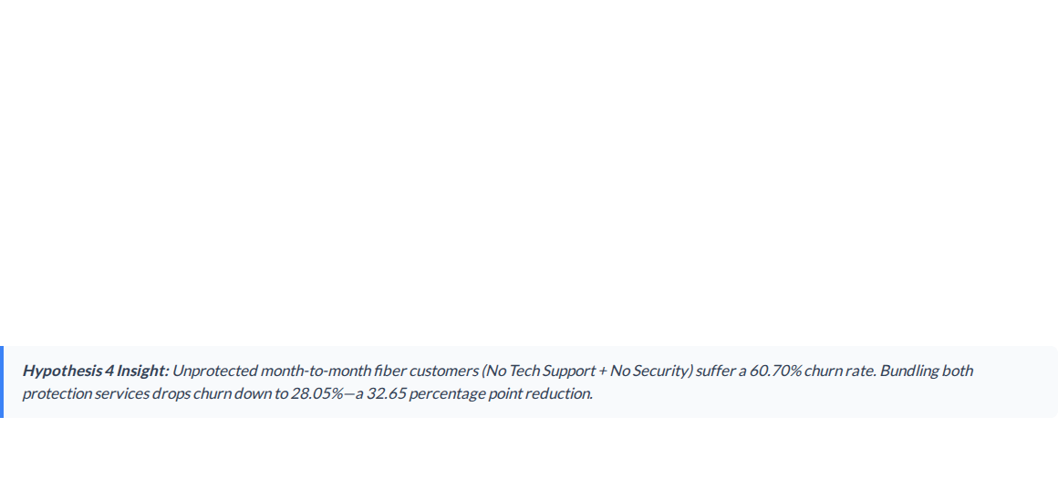

Support & Security Impact Matrix
Technical Support | Online Security | High-Risk Segment Churn Rate | Risk Assessment
No | No | 60.70% | Critical Risk
Yes | No | 42.40% | High Risk
No | Yes | 39.71% | Moderate Risk
Yes | Yes | 28.05% | Low Risk (-32.65%)

Slide 7






Payment Method Churn Drivers
Electronic Check
Mailed Check
Credit Card (Auto)
65.82% Churn Rate
55.47% Churn Rate
47.31% Churn Rate
651 out of 989 high-risk users. Electronic checks represent severe friction or manual payment hesitation among vulnerable accounts.
76 out of 137 users. Manual paper check payments show moderate-to-high churn due to lack of automated billing retention.
88 out of 186 users. Automatic credit card billing yields an 18.51 percentage point improvement over electronic check payments.

Slide 8
Strategic Retention Actions
Incentivize Long-Term Contract Upgrades: Target month-to-month fiber-optic subscribers with initial promotional discounts to migrate them to 1-year or 2-year commitments.
Strengthen Onboarding Programs: Implement proactive check-ins during the first 90 days to enhance perceived service value among new, vulnerable customers.
Bundle Security & Technical Support: Package Online Security and Tech Support into core fiber-optic tiers to cut high-risk segment churn by up to 32.6%.
Transition Electronic Check Users to Auto-Pay: Investigate electronic check billing pain points and offer $5/mo statement credits for enrolling in automatic credit card/bank payments.

Slide 9
Executive Conclusion & Next Steps
Multi-Factor Strategic Focus
Customer churn is driven by a combination of contract flexibility, lack of service support, and billing friction—not simple price resistance.
By executing targeted early onboarding, bundling tech support/security, and migrating users to auto-pay long-term contracts, the company can drastically boost lifetime value and protect core revenue.

